Slide 1
Office etiquette
MNB_training

Slide 2
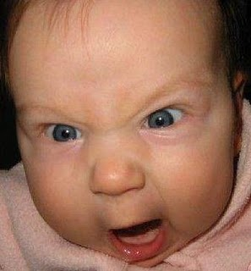
Screamer!!!

Slide 3
Objectives
To define office etiquette and stress the importance of creating a work environment conducive to positive interaction among employees
To identify behaviors considered
important for maintaining
workplace etiquette

Slide 4
What is Etiquette?
Etiquette is a French word which means “ticket”.
On important occasions, a ticket of instructions was issued to the masses detailing what they should do. Thus, the ticket enlists the rules of well-mannered behavior observed in a polite society.
In a professional sense, this includes behavior towards clients and colleagues which is in their best interest.

Slide 5
How does etiquette benefit you?
It helps smooth the wheels of daily interaction in the office.
Good work outcomes and happy co-existence even when there is mutual dislike or disinterest.
Ensures that you don’t become office enemy number 1.
Modifies distracting behaviors and develops admired conduct.
Enables you to be confident in a variety of settings with a variety of people.

Slide 6
What bothers you the most?
Employees are bothered by co-workers who:
Have poor personal hygiene
Don’t clean up after using the office kitchen, sink, wash room, or appliances
Leave trash or personal belongings in other people’s work spaces
Frequently complain
Don’t acknowledge you unless you speak to them directly
Wear clothing that is dirty, too casual, or distracting in some other way

Slide 7
What bothers you the most?
Employees are bothered by co-workers who:
Flirt with co-workers or clients
Drop in on you while working and don’t ask if its okay to interrupt
Habitually arrive late at meetings
Gossip
Borrow things but forget to return them
Have outbursts of anger/yell/curse
Speak too loudly on the telephone

Slide 8
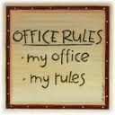
Etiquette Basics
1
UNDERSTAND THE POINT OF OFFICE ETIQUETTE
While the term "office etiquette" may conjure up images
of stiffness and formality, it is in actual fact very simple.
Just as living in a society requires us to
follow a set of conventions and rules, observing
appropriate social behavior within the work
context ensures team respect and an
enjoyable day-to-day working experience.

Slide 9
Etiquette Basics
2
BE PUNCTUAL
Being punctual is very
important, especially if you have
an appointment. It shows that
you respect the time of your
colleagues and in turn it will
compel them to respect your time too. Lead by
example and everything else will fall into place.

Slide 10
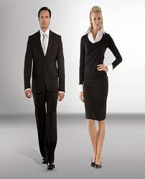
Etiquette Basics
3
DRESS APPROPRIATELY
Remember that the office is not a party place
and you will have to dress in a way that commands
respect both from your colleagues and clients.
The dress code has a strong
influence in establishing the trust
that your client places in your abilities
in giving them their money’s worth.

Slide 11
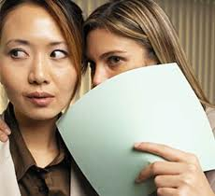
Etiquette Basics
4
STAY AWAY FROM GOSSIP
You would not want someone to gossip about you and neither will the next person. In some cases, if the source of some malicious gossip can be traced back to you, then your job can be in jeopardy.
You may overhear the conversations
of others. Apply the “so what” rule.
Don’t refer to what you’ve heard
and don’t add your own advice.

Slide 12
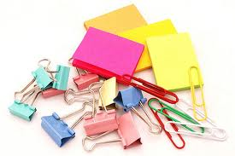
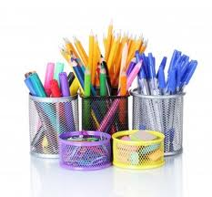
Etiquette Basics
5
ASK BEFORE BORROWING
It is imperative that you ask first and then borrow. This attitude of yours will ensure that people also treat your things with the same respect and your things are not missing (read borrowed) when you get back to your seat after a meeting.

Slide 13
Etiquette Basics
6
ALWAYS SAY PLEASE, THANK YOU, YOU’RE WELCOME, and I’M SORRY
It’s as old as life itself, but still appropriate. It’s never offensive, often expected, and easy to do.
With each request – SAY PLEASE
With each completion – SAY THANK YOU
With each gratitude received – SAY YOU’RE WELCOME
With each error - APOLOGIZE
It’s an attitude. Respect those around you and they will return that respect.

Slide 14
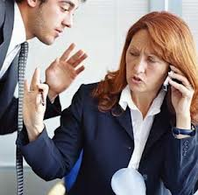
Etiquette Basics
7
DON’T CONSISTENTLY INTERRUPT PEOPLE
Doing so will suggest that your time or opinion is more
important than theirs. If your co-worker is on the phone but you
need to ask a question, don't linger.
If your co-worker is having a
work related conversation don't
interrupt - just wait for them to finish
or ask them to see you when they are
through.

Slide 15
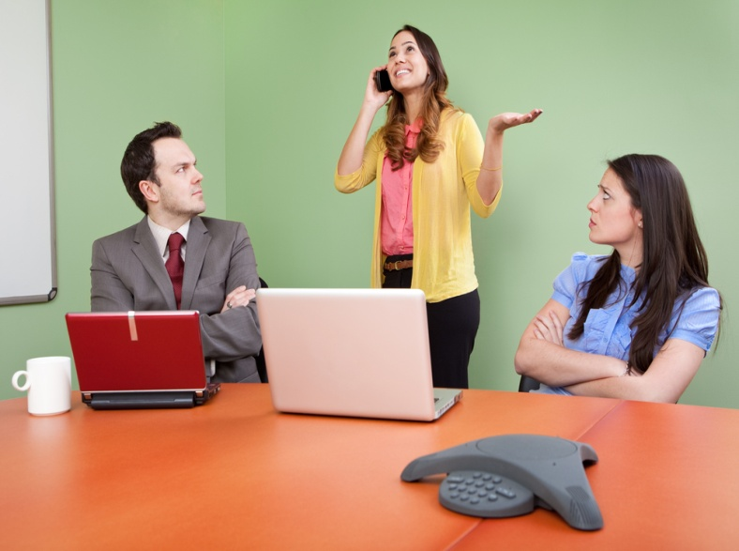
Etiquette Basics
8
REFRAIN FROM BEING LOUD
Whether you're on the phone or talking to a colleague, avoid being loud.
If you have a received a call on your cell phone, it's a good idea to take a walk down to the corridor or find another room.
Use your mobile’s vibrating/silent
feature if you need to leave it on. Avoid
making personal calls at your workstation.
Be especially quiet in areas where
coworkers are on business calls or in
conversations with other coworkers.

Slide 16
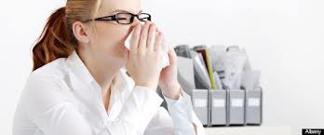
Etiquette Basics
9
STAY HOME WITH THE SNIFFLES
You may feel you should be applauded for bravely soldiering into work when ill, but no-one else will.
If you absolutely must appear,
be considerate and use tissues
and wash your hands frequently
to reduce the spread of germs.

Slide 17
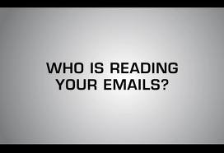
Etiquette Basics
10
BE SENSITIVE TO OTHERS’ NEED FOR PRIVACY
Don’t read someone else’s faxes, emails, mail or
computer screens.
If you need to discuss anything
sensitive or private with another
colleague, find a room where you
can shut the door and nobody else
can overhear you.

Slide 18
“Don’t reserve your best behavior for special occasions. You can’t have two sets of manners, two social codes – one for those you admire and want to impress, another for those whom you consider unimportant. You must be the same to all people.”
~Lillian Eichler Watson

